Slide 1
Propositional and First-Order Logic
CS 63
Chapter 7.4-7.5, 7.7, 8.1─8.3, 8.5
Some material adopted from notes and slides by Tim Finin, Marie desJardins, Andreas Geyer-Schulz and Chuck Dyer

Slide 2
Propositional Logic

Slide 3
Propositional logic
Logical constants: true, false
Propositional symbols: P, Q, S, ... (atomic sentences)
Wrapping parentheses: ( … )
Sentences are combined by connectives:
  ∧ ...and [conjunction]
  ∨ ...or [disjunction]
  ⇒...implies [implication / conditional]
  ⇔..is equivalent [biconditional]
  ¬ ...not [negation]
Literal: atomic sentence or negated atomic sentence

Slide 4
Examples of PL sentences
P means “It is hot.”
Q means “It is humid.”
R means “It is raining.”
(P ∧ Q) → R
  “If it is hot and humid, then it is raining”
Q → P
  “If it is humid, then it is hot”
A better way:
  Hot = “It is hot”
  Humid = “It is humid”
  Raining = “It is raining”

Slide 5
Propositional logic (PL)
A simple language useful for showing key ideas and definitions
User defines a set of propositional symbols, like P and Q.
User defines the semantics of each propositional symbol:
  P means “It is hot”
  Q means “It is humid”
  R means “It is raining”
A sentence (well formed formula) is defined as follows:
  A symbol is a sentence
  If S is a sentence, then ¬S is a sentence
  If S is a sentence, then (S) is a sentence
  If S and T are sentences, then (S ∨ T), (S ∧ T), (S → T), and (S ↔ T) are sentences
  A sentence results from a finite number of applications of the above rules

Slide 6
A BNF grammar of sentences in propositional logic
S := <Sentence> ;
<Sentence> := <AtomicSentence> | <ComplexSentence> ;
<AtomicSentence> := "TRUE" | "FALSE" |
"P" | "Q" | "S" ;
<ComplexSentence> := "(" <Sentence> ")" |
<Sentence> <Connective> <Sentence> |
"NOT" <Sentence> ;
<Connective> := "NOT" | "AND" | "OR" | "IMPLIES" | "EQUIVALENT" ;

Slide 7
Some terms
The meaning or semantics of a sentence determines its interpretation.
Given the truth values of all symbols in a sentence, it can be “evaluated” to determine its truth value (True or False).
A model for a KB is a “possible world” (assignment of truth values to propositional symbols) in which each sentence in the KB is True.

Slide 8
More terms
A valid sentence or tautology is a sentence that is True under all interpretations, no matter what the world is actually like or how the semantics are defined. Example: “It’s raining or it’s not raining.”
An inconsistent sentence or contradiction is a sentence that is False under all interpretations. The world is never like what it describes, as in “It’s raining and it’s not raining.”
P entails Q, written P |= Q, means that whenever P is True, so is Q. In other words, all models of P are also models of Q.

Slide 9
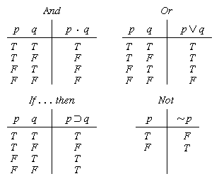
Truth tables

Slide 10


Truth tables II
The five logical connectives:
A complex sentence:

Slide 11
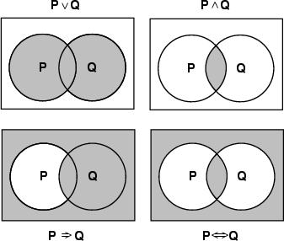
Models of complex sentences

Slide 12
Inference rules
Logical inference is used to create new sentences that logically follow from a given set of predicate calculus sentences (KB).
An inference rule is sound if every sentence X produced by an inference rule operating on a KB logically follows from the KB. (That is, the inference rule does not create any contradictions)
An inference rule is complete if it is able to produce every expression that logically follows from (is entailed by) the KB. (Note the analogy to complete search algorithms.)

Slide 13
Sound rules of inference
Here are some examples of sound rules of inference
  A rule is sound if its conclusion is true whenever the premise is true
Each can be shown to be sound using a truth table
  RULE PREMISE CONCLUSION
  Modus Ponens A, A → B B
  And Introduction A, B A ∧ B
  And Elimination A ∧ B A
  Double Negation ¬¬A A
  Unit Resolution A ∨ B, ¬B A
  Resolution A ∨ B, ¬B ∨ C A ∨ C

Slide 14
Soundness of modus ponens
A | B | A → B | OK?
True | True | True | √
True | False | False | √
False | True | True | √
False | False | True | √

Slide 15
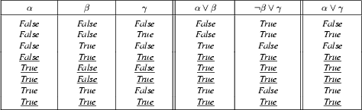
Soundness of the resolution inference rule

Slide 16
Proving things
A proof is a sequence of sentences, where each sentence is either a premise or a sentence derived from earlier sentences in the proof by one of the rules of inference.
The last sentence is the theorem (also called goal or query) that we want to prove.
Example for the “weather problem” given above.
  1 Humid Premise “It is humid”
  2 Humid→Hot Premise “If it is humid, it is hot”
  3 Hot Modus Ponens(1,2) “It is hot”
  4 (Hot∧Humid)→Rain Premise “If it’s hot & humid, it’s raining”
  5 Hot∧Humid And Introduction(1,2) “It is hot and humid”
  6 Rain Modus Ponens(4,5) “It is raining”

Slide 17
Horn sentences
A Horn sentence or Horn clause has the form:
  P1 ∧ P2 ∧ P3 ... ∧ Pn → Q
or alternatively
  ¬P1 ∨ ¬ P2 ∨ ¬ P3 ... ∨ ¬ Pn ∨ Q
where Ps and Q are non-negated atoms
To get a proof for Horn sentences, apply Modus Ponens repeatedly until nothing can be done
We will use the Horn clause form later
(P → Q) = (¬P ∨ Q)

Slide 18
Entailment and derivation
Entailment: KB |= Q
  Q is entailed by KB (a set of premises or assumptions) if and only if there is no logically possible world in which Q is false while all the premises in KB are true.
  Or, stated positively, Q is entailed by KB if and only if the conclusion is true in every logically possible world in which all the premises in KB are true.
Derivation: KB |- Q
  We can derive Q from KB if there is a proof consisting of a sequence of valid inference steps starting from the premises in KB and resulting in Q

Slide 19
Two important properties for inference
Soundness: If KB |- Q then KB |= Q
  If Q is derived from a set of sentences KB using a given set of rules of inference, then Q is entailed by KB.
  Hence, inference produces only real entailments, or any sentence that follows deductively from the premises is valid.
Completeness: If KB |= Q then KB |- Q
  If Q is entailed by a set of sentences KB, then Q can be derived from KB using the rules of inference.
  Hence, inference produces all entailments, or all valid sentences can be proved from the premises.

Slide 20
Propositional logic is a weak language
Hard to identify “individuals” (e.g., Mary, 3)
Can’t directly talk about properties of individuals or relations between individuals (e.g., “Bill is tall”)
Generalizations, patterns, regularities can’t easily be represented (e.g., “all triangles have 3 sides”)
First-Order Logic (abbreviated FOL or FOPC) is expressive enough to concisely represent this kind of information
  FOL adds relations, variables, and quantifiers, e.g.,
    “Every elephant is gray”: ∀ x (elephant(x) → gray(x))
    “There is a white alligator”: ∃ x (alligator(X) ^ white(X))

Slide 21
Example
Consider the problem of representing the following information:
  Every person is mortal.
  Confucius is a person.
  Confucius is mortal.
How can these sentences be represented so that we can infer the third sentence from the first two?

Slide 22
Example II
In PL we have to create propositional symbols to stand for all or part of each sentence. For example, we might have:
  P = “person”; Q = “mortal”; R = “Confucius”
so the above 3 sentences are represented as:
  P → Q; R → P; R → Q
Although the third sentence is entailed by the first two, we needed an explicit symbol, R, to represent an individual, Confucius, who is a member of the classes “person” and “mortal”
To represent other individuals we must introduce separate symbols for each one, with some way to represent the fact that all individuals who are “people” are also “mortal”

Slide 23
The “Hunt the Wumpus” agent
Some atomic propositions:
  S12 = There is a stench in cell (1,2)
  B34 = There is a breeze in cell (3,4)
  W22 = The Wumpus is in cell (2,2)
  V11 = We have visited cell (1,1)
  OK11 = Cell (1,1) is safe.
  etc
Some rules:
  (R1) ¬S11 → ¬W11 ∧ ¬ W12 ∧ ¬ W21
  (R2) ¬ S21 → ¬W11 ∧ ¬ W21 ∧ ¬ W22 ∧ ¬ W31
  (R3) ¬ S12 → ¬W11 ∧ ¬ W12 ∧ ¬ W22 ∧ ¬ W13
  (R4) S12 → W13 ∨ W12 ∨ W22 ∨ W11
  etc
Note that the lack of variables requires us to give similar rules for each cell

Slide 24
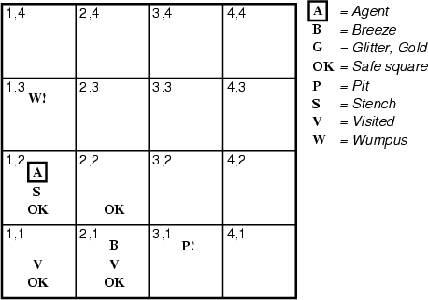
After the third move
We can prove that the Wumpus is in (1,3) using the four rules given.
See R&N section 7.5

Slide 25
Proving W13
Apply MP with ¬S11 and R1:
  ¬ W11 ∧ ¬ W12 ∧ ¬ W21
Apply And-Elimination to this, yielding 3 sentences:
  ¬ W11, ¬ W12, ¬ W21
Apply MP to ~S21 and R2, then apply And-elimination:
  ¬ W22, ¬ W21, ¬ W31
Apply MP to S12 and R4 to obtain:
  W13 ∨ W12 ∨ W22 ∨ W11
Apply Unit resolution on (W13 ∨ W12 ∨ W22 ∨ W11) and ¬W11:
  W13 ∨ W12 ∨ W22
Apply Unit Resolution with (W13 ∨ W12 ∨ W22) and ¬W22:
  W13 ∨ W12
Apply UR with (W13 ∨ W12) and ¬W12:
  W13
QED

Slide 26
Problems with the propositional Wumpus hunter
Lack of variables prevents stating more general rules
  We need a set of similar rules for each cell
Change of the KB over time is difficult to represent
  Standard technique is to index facts with the time when they’re true
  This means we have a separate KB for every time point

Slide 27
Summary
The process of deriving new sentences from old one is called inference.
  Sound inference processes derives true conclusions given true premises
  Complete inference processes derive all true conclusions from a set of premises
A valid sentence is true in all worlds under all interpretations
If an implication sentence can be shown to be valid, then—given its premise—its consequent can be derived
Different logics make different commitments about what the world is made of and what kind of beliefs we can have regarding the facts
  Logics are useful for the commitments they do not make because lack of commitment gives the knowledge base engineer more freedom
Propositional logic commits only to the existence of facts that may or may not be the case in the world being represented
  It has a simple syntax and simple semantics. It suffices to illustrate the process of inference
  Propositional logic quickly becomes impractical, even for very small worlds

Slide 28
First-Order Logic

Slide 29
Outline
First-order logic
  Properties, relations, functions, quantifiers, …
  Terms, sentences, axioms, theories, proofs, …
Extensions to first-order logic
Logical agents
  Reflex agents
  Representing change: situation calculus, frame problem
  Preferences on actions
  Goal-based agents

Slide 30
First-order logic
First-order logic (FOL) models the world in terms of
  Objects, which are things with individual identities
  Properties of objects that distinguish them from other objects
  Relations that hold among sets of objects
  Functions, which are a subset of relations where there is only one “value” for any given “input”
Examples:
  Objects: Students, lectures, companies, cars ...
  Relations: Brother-of, bigger-than, outside, part-of, has-color, occurs-after, owns, visits, precedes, ...
  Properties: blue, oval, even, large, ...
  Functions: father-of, best-friend, second-half, one-more-than ...

Slide 31
User provides
Constant symbols, which represent individuals in the world
  Mary
  3
  Green
Function symbols, which map individuals to individuals
  father-of(Mary) = John
  color-of(Sky) = Blue
Predicate symbols, which map individuals to truth values
  greater(5,3)
  green(Grass)
  color(Grass, Green)

Slide 32
FOL Provides
Variable symbols
  E.g., x, y, foo
Connectives
  Same as in PL: not (¬), and (∧), or (∨), implies (→), if and only if (biconditional ↔)
Quantifiers
  Universal ∀x or (Ax)
  Existential ∃x or (Ex)

Slide 33
Sentences are built from terms and atoms
A term (denoting a real-world individual) is a constant symbol, a variable symbol, or an n-place function of n terms.
  x and f(x₁, ..., x_{n}) are terms, where each x_{i} is a term.
  A term with no variables is a ground term
An atomic sentence (which has value true or false) is an n-place predicate of n terms
A complex sentence is formed from atomic sentences connected by the logical connectives:
  ¬P, P∨Q, P∧Q, P→Q, P↔Q where P and Q are sentences
A quantified sentence adds quantifiers ∀ and ∃
A well-formed formula (wff) is a sentence containing no “free” variables. That is, all variables are “bound” by universal or existential quantifiers.
  (∀x)P(x,y) has x bound as a universally quantified variable, but y is free.

Slide 34
A BNF for FOL
S := <Sentence> ;
<Sentence> := <AtomicSentence> |
<Sentence> <Connective> <Sentence> |
<Quantifier> <Variable>,... <Sentence> |
"NOT" <Sentence> |
"(" <Sentence> ")";
<AtomicSentence> := <Predicate> "(" <Term>, ... ")" |
<Term> "=" <Term>;
<Term> := <Function> "(" <Term>, ... ")" |
<Constant> |
<Variable>;
<Connective> := "AND" | "OR" | "IMPLIES" | "EQUIVALENT";
<Quantifier> := "EXISTS" | "FORALL" ;
<Constant> := "A" | "X1" | "John" | ... ;
<Variable> := "a" | "x" | "s" | ... ;
<Predicate> := "Before" | "HasColor" | "Raining" | ... ;
<Function> := "Mother" | "LeftLegOf" | ... ;

Slide 35
Quantifiers
Universal quantification
  (∀x)P(x) means that P holds for all values of x in the domain associated with that variable
  E.g., (∀x) dolphin(x) → mammal(x)
Existential quantification
  (∃ x)P(x) means that P holds for some value of x in the domain associated with that variable
  E.g., (∃ x) mammal(x) ∧ lays-eggs(x)
  Permits one to make a statement about some object without naming it

Slide 36
Quantifiers
Universal quantifiers are often used with “implies” to form “rules”:
  (∀x) student(x) → smart(x) means “All students are smart”
Universal quantification is rarely used to make blanket statements about every individual in the world:
  (∀x)student(x)∧smart(x) means “Everyone in the world is a student and is smart”
Existential quantifiers are usually used with “and” to specify a list of properties about an individual:
  (∃x) student(x) ∧ smart(x) means “There is a student who is smart”
A common mistake is to represent this English sentence as the FOL sentence:
  (∃x) student(x) → smart(x)
  But what happens when there is a person who is not a student?

Slide 37
Quantifier Scope
Switching the order of universal quantifiers does not change the meaning:
  (∀x)(∀y)P(x,y) ↔ (∀y)(∀x) P(x,y)
Similarly, you can switch the order of existential quantifiers:
  (∃x)(∃y)P(x,y) ↔ (∃y)(∃x) P(x,y)
Switching the order of universals and existentials does change meaning:
  Everyone likes someone: (∀x)(∃y) likes(x,y)
  Someone is liked by everyone: (∃y)(∀x) likes(x,y)

Slide 38
Connections between All and Exists
We can relate sentences involving ∀ and ∃ using De Morgan’s laws:
    (∀x) ¬P(x) ↔ ¬(∃x) P(x)
    ¬(∀x) P ↔ (∃x) ¬P(x)
    (∀x) P(x) ↔ ¬ (∃x) ¬P(x)
    (∃x) P(x) ↔ ¬(∀x) ¬P(x)

Slide 39
Quantified inference rules
Universal instantiation
  ∀x P(x) ∴ P(A)
Universal generalization
  P(A) ∧ P(B) … ∴ ∀x P(x)
Existential instantiation
  ∃x P(x) ∴P(F) ← skolem constant F
Existential generalization
  P(A) ∴ ∃x P(x)

Slide 40
Universal instantiation
(a.k.a. universal elimination)
If (∀x) P(x) is true, then P(C) is true, where C is any constant in the domain of x
Example:
  (∀x) eats(Ziggy, x) ⇒ eats(Ziggy, IceCream)
The variable symbol can be replaced by any ground term, i.e., any constant symbol or function symbol applied to ground terms only

Slide 41
Existential instantiation
(a.k.a. existential elimination)
From (∃x) P(x) infer P(c)
Example:
  (∃x) eats(Ziggy, x) → eats(Ziggy, Stuff)
Note that the variable is replaced by a brand-new constant not occurring in this or any other sentence in the KB
Also known as skolemization; constant is a skolem constant
In other words, we don’t want to accidentally draw other inferences about it by introducing the constant
Convenient to use this to reason about the unknown object, rather than constantly manipulating the existential quantifier

Slide 42
Existential generalization
(a.k.a. existential introduction)
If P(c) is true, then (∃x) P(x) is inferred.
Example
  eats(Ziggy, IceCream) ⇒ (∃x) eats(Ziggy, x)
All instances of the given constant symbol are replaced by the new variable symbol
Note that the variable symbol cannot already exist anywhere in the expression

Slide 43
Translating English to FOL
Every gardener likes the sun.
  ∀x gardener(x) → likes(x,Sun)
You can fool some of the people all of the time.
  ∃x ∀t person(x) ∧time(t) → can-fool(x,t)
You can fool all of the people some of the time.
  ∀x ∃t (person(x) → time(t) ∧can-fool(x,t))
  ∀x (person(x) → ∃t (time(t) ∧can-fool(x,t)))
All purple mushrooms are poisonous.
  ∀x (mushroom(x) ∧ purple(x)) → poisonous(x)
No purple mushroom is poisonous.
  ¬∃x purple(x) ∧ mushroom(x) ∧ poisonous(x)
  ∀x (mushroom(x) ∧ purple(x)) → ¬poisonous(x)
There are exactly two purple mushrooms.
  ∃x ∃y mushroom(x) ∧ purple(x) ∧ mushroom(y) ∧ purple(y) ^ ¬(x=y) ∧ ∀z (mushroom(z) ∧ purple(z)) → ((x=z) ∨ (y=z))
Clinton is not tall.
  ¬tall(Clinton)
X is above Y iff X is on directly on top of Y or there is a pile of one or more other objects directly on top of one another starting with X and ending with Y.
  ∀x ∀y above(x,y) ↔ (on(x,y) ∨ ∃z (on(x,z) ∧ above(z,y)))
Equivalent
Equivalent

Slide 44
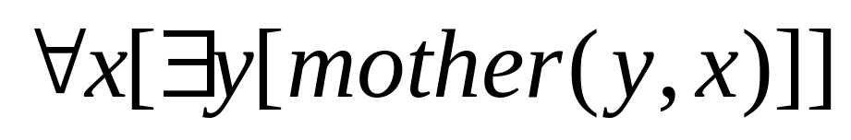
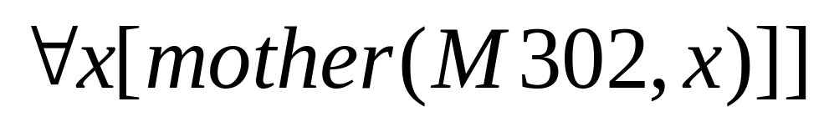
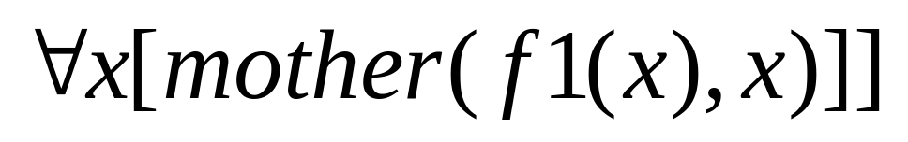
Skolemisation II
Actually Skolemisation is slightly more complicated. Consider this:
If just replace the existential quantification with a constant we get
Which says M302 is everyone’s mother.
What we should do when there are universally quantified variables in the surrounding scope is make the existential variable a function (called a Skolem function) of those universally quantified variables. So:
Here, f1(k) is the Skolem function, outputting the individual who is the mother of the input variable k.

Slide 45


A Procedure for Conversioon of FOL into CNF Form
There are six stages to the conversion:
Remove
De Morgan’s to move negation to atomic propositions
Skolemizing (gets rid of )
`Eliminating’ universal quantifiers
Distributing AND over OR
Arrange into clauses and maybe reorder

Slide 46
Unification
We can get the inference immediately if we can find a substitution θ such that King(x) and Greedy(x) match King(John) and Greedy(y)
θ = {x/John,y/John} works
Unify(α,β) = θ if αθ = βθ
p q θ
Knows(John,x) Knows(John,Jane) {x/Jane}}
Knows(John,x) Knows(y,OJ) {x/OJ,y/John}}
Knows(John,x) Knows(y,Mother(y)) {y/John,x/Mother(John)}}
Knows(John,x) Knows(x,OJ) {fail}
Standardizing apart eliminates overlap of variables, e.g., Knows(z₁₇,OJ)

Slide 47
UNIFICATION ALGORITHM
Algorithm: Unify(L1, L2)
I. If L1 or L2 are both variables or constants, then:
(a) If L1 and L2 are identical, then return NIL.
(b) Else if L1 is a variable, then if L1 occurs in L2 then return {FAIL}, else return (L2/L1).
(c) Else if L2 is a variable, then if L2 occurs in L1 then return {FAIL} , else return (L1/L2).
(d) Else return {FAIL}.
2. If the initial predicate symbols in L1 and L2 are not identical, then return {FAIL}.
3. If LI and L2 have a different number of arguments, then return {FAIL}.

Slide 48
4. Set SUBST to NIL. (At the end of this procedure, SUBST will contain all the substitutions used to unify L1 and L2.)
5. For i ← 1 to number of arguments in L1 :
(a) Call Unify with the ith argument of L1 and the ith argument of L2, putting result in S.
(b) If S contains FAIL then return {FAIL}.
(c) If S is not equal to NIL then:
(i) Apply S to the remainder of both L1 and L2.
(ii) SUBST: = APPEND(S, SUBST).
6. Return SUBST.

Slide 49
Using FOL
The set domain:
∀s Set(s) ⇔ (s = {} ) ∨ (∃x,s₂ Set(s₂) ∧ s = {x|s₂})
∀s₁,s₂ (s₁ = s₂) ⇔ (s₁ ⊆ s₂ ∧ s₂ ⊆ s₁)
x,s1,s2 x  (s1  s2)  (x  s1  x  s2)
x,s1,s2 x  (s1  s2)  (x  s1  x  s2)
➢x,s {x|s} = {}
x,s x  s  s = {x|s}
x,s x  s  [ y,s2} (s = {y|s2}  (x = y  x  s2))]
s1,s2 s1  s2  (x x  s1  x  s2)
Note: x|s2 is the set resulting from adjoining x to set s2

Slide 50
Algorithm: Resolution
1. Convert all the statements of F to clause form.
2. Negate P and convert the result to clause form. Add it to the set of clauses obtained in 1.
3. Repeat until either a contradiction is found , no progress can be made, or a predetermined amount of effort has been expended.
(a) Select two clauses. Call these the parent clauses.
(b) Resolve them together. The resolvent will be the disjunction of all the literals of both parent clauses with appropriate substitutions performed and with the following exception:

Slide 51
If there is one pair of literals T1 and ¬ T2 such that one of the parent clauses contains T2 and the other contains T1 and if T1 and T2 are unifiable, then neither T1 nor T2 should appear in the resolvent. We call T1 and T2 Complementary literals. Use the substitution produced by the unification to create the resolvent. If there is more than one pair of complementary literals, only one pair should be omitted from the resolvent.
(c) If the resolvent is the empty clause, then a contradiction has been found. If it is not, then add it to
the set of clauses available to the procedure.

Slide 52
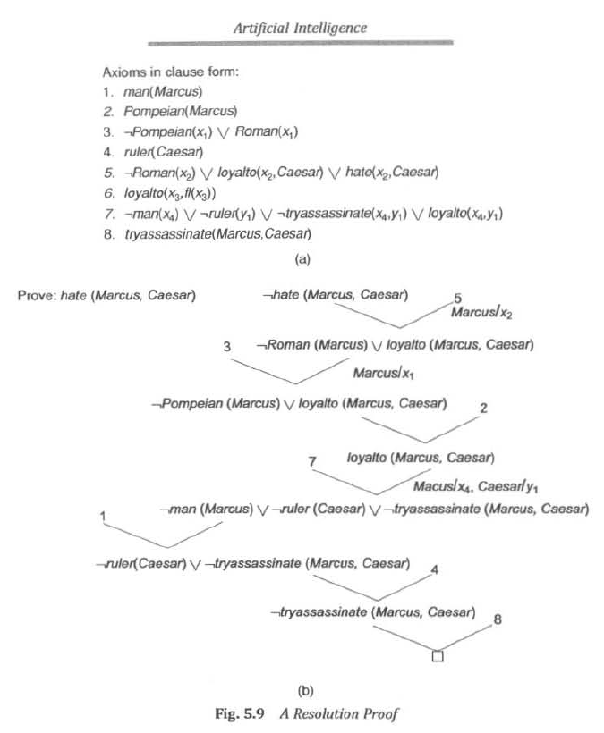


Slide 53
Example 2
1. Marcus was a man.
man(Marcus)
2. Marcus was a Pompeian.
Pompeian(Marcus)
3. Marcus was born in 40 A.D.
born(Marcus, 40)
4. All men are mortal.
∀x: man(x) → mortal(x)
5. All Pompeians died when the volcano erupted in 79 A.D.
erupted(volcano, 79) ∧ ∀ x : [Pompeian(x) → died(x, 79)]
6. No mortal lives longer than 150 years.
∀x: ∀t1: At2: mortal(x) ∧ born(x, t1) ∧ gt(t2 - t1,150) → died(x, t2)
7. It is now 2017.
now = 2017
Query: "Is Marcus alive?”

Slide 54
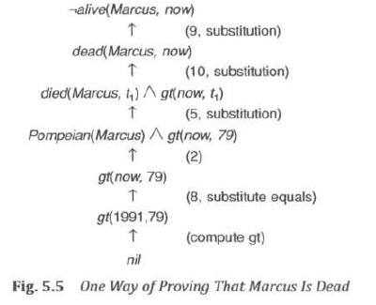

Slide 55
Using FOL
The kinship domain:
Brothers are siblings
  ∀x,y Brother(x,y) ⇔ Sibling(x,y)
One's mother is one's female parent
  ∀m,c Mother(c) = m ⇔ (Female(m) ∧ Parent(m,c))
“Sibling” is symmetric
  ∀x,y Sibling(x,y) ⇔ Sibling(y,x)

Slide 56
Monty Python and The Art of Fallacy
Cast
  Sir Bedevere the Wise, master of (odd) logic
  King Arthur
  Villager 1, witch-hunter
  Villager 2, ex-newt
  Villager 3, one-line wonder
  All, the rest of you scoundrels, mongrels, and nere-do-wells.

Slide 57
An example from Monty Python by way of Russell & Norvig
FIRST VILLAGER: We have found a witch. May we burn her?
ALL: A witch! Burn her!
BEDEVERE: Why do you think she is a witch?
SECOND VILLAGER: She turned me into a newt.
B: A newt?
V2 (after looking at himself for some time): I got better.
ALL: Burn her anyway.
B: Quiet! Quiet! There are ways of telling whether she is a witch.

Slide 58
Monty Python cont.
B: Tell me… what do you do with witches?
ALL: Burn them!
B: And what do you burn, apart from witches?
Third Villager: …wood?
B: So why do witches burn?
V2 (after a beat): because they’re made of wood?
B: Good.
ALL: I see. Yes, of course.

Slide 59
Monty Python cont.
B: So how can we tell if she is made of wood?
V1: Make a bridge out of her.
B: Ah… but can you not also make bridges out of stone?
ALL: Yes, of course… um… er…
B: Does wood sink in water?
ALL: No, no, it floats. Throw her in the pond.
B: Wait. Wait… tell me, what also floats on water?
ALL: Bread? No, no no. Apples… gravy… very small rocks…
B: No, no, no,

Slide 60
Monty Python cont.
KING ARTHUR: A duck!
(They all turn and look at Arthur. Bedevere looks up, very impressed.)
B: Exactly. So… logically…
V1 (beginning to pick up the thread): If she… weighs the same as a duck… she’s made of wood.
B: And therefore?
ALL: A witch!

Slide 61
Monty Python Fallacy #1
∀x witch(x) → burns(x)
∀x wood(x) → burns(x)
-------------------------------
∴ ∀z witch(x) → wood(x)
p → q
r → q
---------
p → r Fallacy: Affirming the conclusion

Slide 62
Monty Python Near-Fallacy #2
wood(x) → can-build-bridge(x)
-----------------------------------------
∴ can-build-bridge(x) → wood(x)
B: Ah… but can you not also make bridges out of stone?

Slide 63
Monty Python Fallacy #3
∀x wood(x) → floats(x)
∀x duck-weight (x) → floats(x)
-------------------------------
∴ ∀x duck-weight(x) → wood(x)
p → q
r → q
-----------
∴ r → p

Slide 64
Monty Python Fallacy #4
∀z light(z) → wood(z)
light(W)
------------------------------
∴ wood(W) ok…………..
witch(W) → wood(W) applying universal instan.
to fallacious conclusion #1
wood(W)
---------------------------------
∴ witch(z)

Slide 65
Example: A simple genealogy KB by FOL
Build a small genealogy knowledge base using FOL that
  contains facts of immediate family relations (spouses, parents, etc.)
  contains definitions of more complex relations (ancestors, relatives)
  is able to answer queries about relationships between people
Predicates:
  parent(x, y), child(x, y), father(x, y), daughter(x, y), etc.
  spouse(x, y), husband(x, y), wife(x,y)
  ancestor(x, y), descendant(x, y)
  male(x), female(y)
  relative(x, y)
Facts:
  husband(Joe, Mary), son(Fred, Joe)
  spouse(John, Nancy), male(John), son(Mark, Nancy)
  father(Jack, Nancy), daughter(Linda, Jack)
  daughter(Liz, Linda)
  etc.

Slide 66
Rules for genealogical relations
  (∀x,y) parent(x, y) ↔ child (y, x)
  (∀x,y) father(x, y) ↔ parent(x, y) ∧ male(x) (similarly for mother(x, y))
  (∀x,y) daughter(x, y) ↔ child(x, y) ∧ female(x) (similarly for son(x, y))
  (∀x,y) husband(x, y) ↔ spouse(x, y) ∧ male(x) (similarly for wife(x, y))
  (∀x,y) spouse(x, y) ↔ spouse(y, x) (spouse relation is symmetric)
  (∀x,y) parent(x, y) → ancestor(x, y)
  (∀x,y)(∃z) parent(x, z) ∧ ancestor(z, y) → ancestor(x, y)
  (∀x,y) descendant(x, y) ↔ ancestor(y, x)
  (∀x,y)(∃z) ancestor(z, x) ∧ ancestor(z, y) → relative(x, y)
  (related by common ancestry)
  (∀x,y) spouse(x, y) → relative(x, y) (related by marriage)
  (∀x,y)(∃z) relative(z, x) ∧ relative(z, y) → relative(x, y) (transitive)
  (∀x,y) relative(x, y) ↔ relative(y, x) (symmetric)
Queries
  ancestor(Jack, Fred) /* the answer is yes */
  relative(Liz, Joe) /* the answer is yes */
  relative(Nancy, Matthew)
  /* no answer in general, no if under closed world assumption */
  (∃z) ancestor(z, Fred) ∧ ancestor(z, Liz)

Slide 67
Axioms for Set Theory in FOL
1. The only sets are the empty set and those made by adjoining something to a set:
  ∀s set(s) <=> (s=EmptySet) v (∃x,r Set(r) ^ s=Adjoin(s,r))
2. The empty set has no elements adjoined to it:
  ~ ∃x,s Adjoin(x,s)=EmptySet
3. Adjoining an element already in the set has no effect:
  ∀x,s Member(x,s) <=> s=Adjoin(x,s)
4. The only members of a set are the elements that were adjoined into it:
  ∀x,s Member(x,s) <=> ∃y,r (s=Adjoin(y,r) ^ (x=y ∨ Member(x,r)))
5. A set is a subset of another iff all of the 1st set’s members are members of the 2nd:
  ∀s,r Subset(s,r) <=> (∀x Member(x,s) => Member(x,r))
6. Two sets are equal iff each is a subset of the other:
  ∀s,r (s=r) <=> (subset(s,r) ^ subset(r,s))
7. Intersection
  ∀x,s1,s2 member(X,intersection(S1,S2)) <=> member(X,s1) ^ member(X,s2)
8. Union
  ∃x,s1,s2 member(X,union(s1,s2)) <=> member(X,s1) ∨ member(X,s2)

Slide 68
Semantics of FOL
Domain M: the set of all objects in the world (of interest)
Interpretation I: includes
  Assign each constant to an object in M
  Define each function of n arguments as a mapping M^{n} => M
  Define each predicate of n arguments as a mapping M^{n} => {T, F}
  Therefore, every ground predicate with any instantiation will have a truth value
  In general there is an infinite number of interpretations because |M| is infinite
Define logical connectives: ~, ^, ∨, =>, <=> as in PL
Define semantics of (∀x) and (∃x)
  (∀x) P(x) is true iff P(x) is true under all interpretations
  (∃x) P(x) is true iff P(x) is true under some interpretation

Slide 69
Model: an interpretation of a set of sentences such that every sentence is True
A sentence is
  satisfiable if it is true under some interpretation
  valid if it is true under all possible interpretations
  inconsistent if there does not exist any interpretation under which the sentence is true
Logical consequence: S |= X if all models of S are also
models of X

Slide 70
Axioms, definitions and theorems
Axioms are facts and rules that attempt to capture all of the (important) facts and concepts about a domain; axioms can be used to prove theorems
  Mathematicians don’t want any unnecessary (dependent) axioms –ones that can be derived from other axioms
  Dependent axioms can make reasoning faster, however
  Choosing a good set of axioms for a domain is a kind of design problem
A definition of a predicate is of the form “p(X) ↔ …” and can be decomposed into two parts
  Necessary description: “p(x) → …”
  Sufficient description “p(x) ← …”
  Some concepts don’t have complete definitions (e.g., person(x))

Slide 71
More on definitions
A necessary condition must be satisfied for a statement to be true.
A sufficient condition, if satisfied, assures the statement’s truth.
Duality: “P is sufficient for Q” is the same as “Q is necessary for P.”
Examples: define father(x, y) by parent(x, y) and male(x)
  parent(x, y) is a necessary (but not sufficient) description of
  father(x, y)
    father(x, y) → parent(x, y)
  parent(x, y) ^ male(x) ^ age(x, 35) is a sufficient (but not necessary) description of father(x, y):
  father(x, y) ← parent(x, y) ^ male(x) ^ age(x, 35)
  parent(x, y) ^ male(x) is a necessary and sufficient description of father(x, y)
  parent(x, y) ^ male(x) ↔ father(x, y)

Slide 72
More on definitions
S(x) is a necessary condition of P(x)
P(x)
S(x)
(∀x) P(x) => S(x)
S(x) is a sufficient condition of P(x)
S(x)
P(x)
(∀x) P(x) <= S(x)
S(x) is a necessary and sufficient condition of P(x)
P(x)
S(x)
(∀x) P(x) <=> S(x)

Slide 73
Higher-order logic
FOL only allows to quantify over variables, and variables can only range over objects.
HOL allows us to quantify over relations
Example: (quantify over functions)
  “two functions are equal iff they produce the same value for all arguments”
  ∀f ∀g (f = g) ↔ (∀x f(x) = g(x))
Example: (quantify over predicates)
  ∀r transitive( r ) → (∀xyz) r(x,y) ∧ r(y,z) → r(x,z))
More expressive, but undecidable. (there isn’t an effective algorithm to decide whether all sentences are valid)
  First-order logic is decidable only when it uses predicates with only one argument.

Slide 74
Expressing uniqueness
Sometimes we want to say that there is a single, unique object that satisfies a certain condition
“There exists a unique x such that king(x) is true”
  ∃x king(x) ∧ ∀y (king(y) → x=y)
  ∃x king(x) ∧ ¬∃y (king(y) ∧ x≠y)
  ∃! x king(x)
“Every country has exactly one ruler”
  ∀c country(c) → ∃! r ruler(c,r)
Iota operator: “ι x P(x)” means “the unique x such that p(x) is true”
  “The unique ruler of Freedonia is dead”
  dead(ι x ruler(freedonia,x))

Slide 75
Notational differences
Different symbols for and, or, not, implies, ...
  ∀ ∃ ⇒ ⇔ ∧ ∨ ¬ • ⊃
  p v (q ^ r)
  p + (q * r)
  etc
Prolog
  cat(X) :- furry(X), meows (X), has(X, claws)
Lispy notations
  (forall ?x (implies (and (furry ?x)
  (meows ?x)
  (has ?x claws))
  (cat ?x)))

Slide 76
Logical agents for the Wumpus World
Three (non-exclusive) agent architectures:
  Reflex agents
    Have rules that classify situations, specifying how to react to each possible situation
  Model-based agents
    Construct an internal model of their world
  Goal-based agents
    Form goals and try to achieve them

Slide 77
A simple reflex agent
Rules to map percepts into observations:
  ∀b,g,u,c,t Percept([Stench, b, g, u, c], t) → Stench(t)
  ∀s,g,u,c,t Percept([s, Breeze, g, u, c], t) → Breeze(t)
  ∀s,b,u,c,t Percept([s, b, Glitter, u, c], t) → AtGold(t)
Rules to select an action given observations:
  ∀t AtGold(t) → Action(Grab, t);
Some difficulties:
  Consider Climb. There is no percept that indicates the agent should climb out – position and holding gold are not part of the percept sequence
  Loops – the percept will be repeated when you return to a square, which should cause the same response (unless we maintain some internal model of the world)

Slide 78
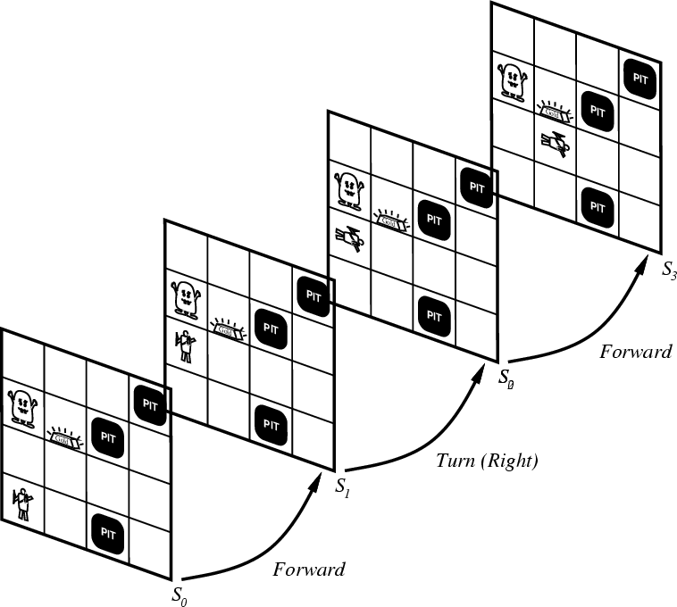
Representing change
Representing change in the world in logic can be tricky.
One way is just to change the KB
  Add and delete sentences from the KB to reflect changes
  How do we remember the past, or reason about changes?
Situation calculus is another way
A situation is a snapshot of the world at some instant in time
When the agent performs an action A in situation S1, the result is a new situation S2.

Slide 79
Situations

Slide 80
Situation calculus
A situation is a snapshot of the world at an interval of time during which nothing changes
Every true or false statement is made with respect to a particular situation.
  Add situation variables to every predicate.
  at(Agent,1,1) becomes at(Agent,1,1,s0): at(Agent,1,1) is true in situation (i.e., state) s0.
  Alternatively, add a special 2nd-order predicate, holds(f,s), that means “f is true in situation s.” E.g., holds(at(Agent,1,1),s0)
Add a new function, result(a,s), that maps a situation s into a new situation as a result of performing action a. For example, result(forward, s) is a function that returns the successor state (situation) to s
Example: The action agent-walks-to-location-y could be represented by
  (∀x)(∀y)(∀s) (at(Agent,x,s) ∧ ¬onbox(s)) → at(Agent,y,result(walk(y),s))

Slide 81
Deducing hidden properties
From the perceptual information we obtain in situations, we can infer properties of locations
  ∀l,s at(Agent,l,s) ∧ Breeze(s) → Breezy(l)
  ∀l,s at(Agent,l,s) ∧ Stench(s) → Smelly(l)
Neither Breezy nor Smelly need situation arguments because pits and Wumpuses do not move around

Slide 82
Deducing hidden properties II
We need to write some rules that relate various aspects of a single world state (as opposed to across states)
There are two main kinds of such rules:
  Causal rules reflect the assumed direction of causality in the world:
    (∀l1,l2,s) At(Wumpus,l1,s) ∧ Adjacent(l1,l2) → Smelly(l2)
    (∀ l1,l2,s) At(Pit,l1,s) ∧ Adjacent(l1,l2) → Breezy(l2)
  Systems that reason with causal rules are called model-based reasoning systems
  Diagnostic rules infer the presence of hidden properties directly from the percept-derived information. We have already seen two diagnostic rules:
    (∀ l,s) At(Agent,l,s) ∧ Breeze(s) → Breezy(l)
    (∀ l,s) At(Agent,l,s) ∧ Stench(s) → Smelly(l)

Slide 83
Representing change:
The frame problem
Frame axioms: If property x doesn’t change as a result of applying action a in state s, then it stays the same.
  On (x, z, s) ∧ Clear (x, s) →
  On (x, table, Result(Move(x, table), s)) ∧
  ¬On(x, z, Result (Move (x, table), s))
  On (y, z, s) ∧ y≠ x → On (y, z, Result (Move (x, table), s))
  The proliferation of frame axioms becomes very cumbersome in complex domains

Slide 84
The frame problem II
Successor-state axiom: General statement that characterizes every way in which a particular predicate can become true:
  Either it can be made true, or it can already be true and not be changed:
  On (x, table, Result(a,s)) ↔
  [On (x, z, s) ∧ Clear (x, s) ∧ a = Move(x, table)] ∧
  [On (x, table, s) ∧ a ≠ Move (x, z)]
In complex worlds, where you want to reason about longer chains of action, even these types of axioms are too cumbersome
  Planning systems use special-purpose inference methods to reason about the expected state of the world at any point in time during a multi-step plan

Slide 85
Qualification problem
Qualification problem:
  How can you possibly characterize every single effect of an action, or every single exception that might occur?
  When I put my bread into the toaster, and push the button, it will become toasted after two minutes, unless…
    The toaster is broken, or…
    The power is out, or…
    I blow a fuse, or…
    A neutron bomb explodes nearby and fries all electrical components, or…
    A meteor strikes the earth, and the world we know it ceases to exist, or…

Slide 86
Ramification problem
Similarly, it’s just about impossible to characterize every side effect of every action, at every possible level of detail:
  When I put my bread into the toaster, and push the button, the bread will become toasted after two minutes, and…
    The crumbs that fall off the bread onto the bottom of the toaster over tray will also become toasted, and…
    Some of the aforementioned crumbs will become burnt, and…
    The outside molecules of the bread will become “toasted,” and…
    The inside molecules of the bread will remain more “breadlike,” and…
    The toasting process will release a small amount of humidity into the air because of evaporation, and…
    The heating elements will become a tiny fraction more likely to burn out the next time I use the toaster, and…
    The electricity meter in the house will move up slightly, and…

Slide 87
Knowledge engineering!
Modeling the “right” conditions and the “right” effects at the “right” level of abstraction is very difficult
Knowledge engineering (creating and maintaining knowledge bases for intelligent reasoning) is an entire field of investigation
Many researchers hope that automated knowledge acquisition and machine learning tools can fill the gap:
  Our intelligent systems should be able to learn about the conditions and effects, just like we do!
  Our intelligent systems should be able to learn when to pay attention to, or reason about, certain aspects of processes, depending on the context!

Slide 88
Preferences among actions
A problem with the Wumpus world knowledge base that we have built so far is that it is difficult to decide which action is best among a number of possibilities.
For example, to decide between a forward and a grab, axioms describing when it is OK to move to a square would have to mention glitter.
This is not modular!
We can solve this problem by separating facts about actions from facts about goals. This way our agent can be reprogrammed just by asking it to achieve different goals.

Slide 89
Preferences among actions
The first step is to describe the desirability of actions independent of each other.
In doing this we will use a simple scale: actions can be Great, Good, Medium, Risky, or Deadly.
Obviously, the agent should always do the best action it can find:
  (∀a,s) Great(a,s) → Action(a,s)
  (∀a,s) Good(a,s) ∧ ¬(∃b) Great(b,s) → Action(a,s)
  (∀a,s) Medium(a,s) ∧ (¬(∃b) Great(b,s) ∨ Good(b,s)) → Action(a,s)
  ...

Slide 90
Preferences among actions
We use this action quality scale in the following way.
Until it finds the gold, the basic strategy for our agent is:
  Great actions include picking up the gold when found and climbing out of the cave with the gold.
  Good actions include moving to a square that’s OK and hasn't been visited yet.
  Medium actions include moving to a square that is OK and has already been visited.
  Risky actions include moving to a square that is not known to be deadly or OK.
  Deadly actions are moving into a square that is known to have a pit or a Wumpus.

Slide 91
Goal-based agents
Once the gold is found, it is necessary to change strategies. So now we need a new set of action values.
We could encode this as a rule:
  (∀s) Holding(Gold,s) → GoalLocation([1,1]),s)
We must now decide how the agent will work out a sequence of actions to accomplish the goal.
Three possible approaches are:
  Inference: good versus wasteful solutions
  Search: make a problem with operators and set of states
  Planning: to be discussed later

